Slide 1
Introduction to Literary Studies pt3

Slide 2
Introduction to Narrative Fiction
Narrative: contains a story, at least one event that induces change
Possible worlds – it doesn’t have to be real, only resemble reality
Story: chronological succession of events and contains characters
“The story is an abstraction from the represented world (the fictional reality) in the narrative. This is the essence of the narrative that can be paraphrased, it is transferable from medium to medium (the same story can be used in a drama, a novel, a film, a musical production etc.)”
Plot: narrative developed by the author - does not have to be chronological
Characters
- complexity (flat vs complex)
- development (developing vs non-developing characters

Slide 3
Introduction to Narrative Fiction
Text: a story developed through a plot.
Plot development techniques:
1. Time: there is difference between text time (the amount of time the reader needs to read a story) and story time (elapsed time in the story read).
Differences in time order: analepsis (flashback), prolepsis (jump forward)
Difference in duration: acceleration (time speeds up), scene (story duration same as text duration), deceleration (story slows down)
2. Focalization: mediation, perspective of the story. System of points of view in a text.
Types:
external or internal (position of perspective: eg. 1st person or 3rd person narration)
Fixed, variable, multiple (eg. Sometimes two or people can narrate a text)

Slide 4
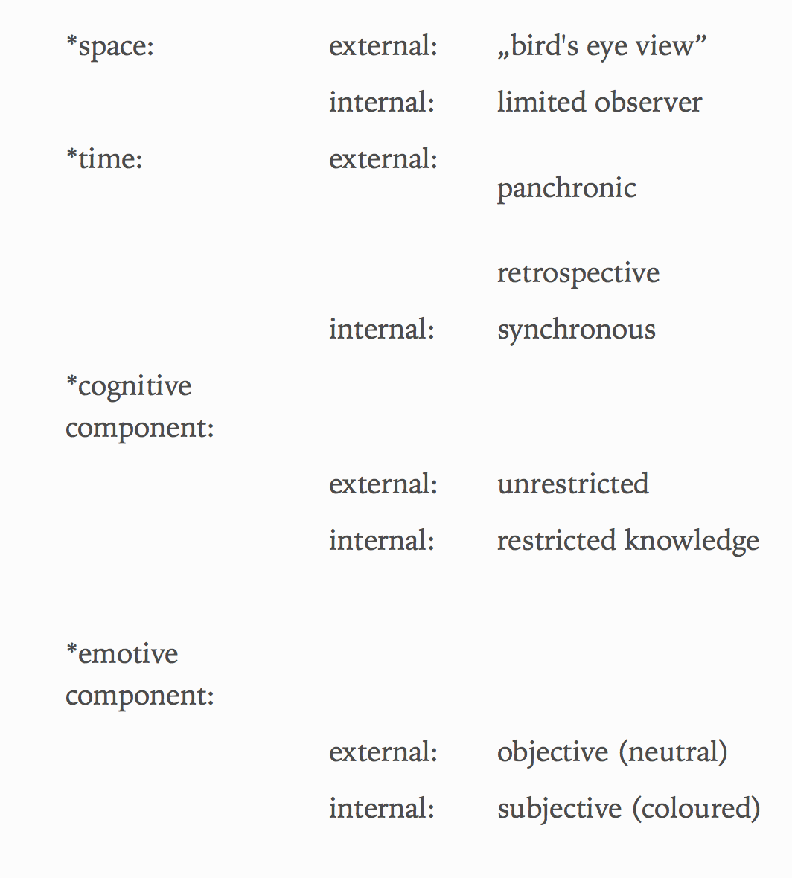
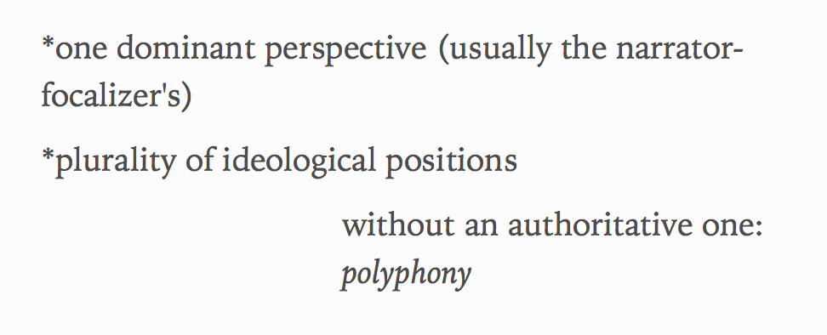
Facets of focalization

Slide 5
Facets of focalization
Can you name examples for the above?
“The polyphonic novel provides the reader with the greatest challenge, because we have to decide which ideological perspective we trust. In a polyphonic novel, the plot might be unfolding through the narration of several narrators, each having a different ideological position.”Excerpt From: Kiss Attila, Matuska Ágnes. “Introduction to the Study of Cultures and Literatures in English.” iBooks
Restricted knowledge – is it better than an all knowing narrator?
How does the restricted knowledge relate to film narration?
Objective: is it realistically possible?

Slide 6
Nathaniel Hawthorne: The Artist of the Beautiful (1884)
N. Hawthorne: prolific author from the American Romanticism
How does the shorts story’s narrative relate to our reality?
Name magical elements in the story.
First level of understanding:
Formal characteristics: prose has a more free form than poetry.
Hawthorne called his short stories tales: why do you think he did?
Identify the narrator: what is his/her perspective? Is it objective or subjective?
Is the narrator reliable?
Ideological perspectives: world of matter vs world of spirituality
Allegorical tale – characters have many levels of meaning

Slide 7
The Artist of the Beautiful
Character symbolism – second level of understanding
Owen: slender, sensitive figure, tortured artist, genius, Apollon, Prometheus,
Annie: angelic figure, ‘Laura’ (Petrarca), sensitive, innocent, dull, cannot understand complex ideas
Danforth: brute force, earthiness, strength, lack of delicacy, stupid, dull
Peter Hovenden: old, cynical, skeptical, doubt
Butterfly: ethereal beauty in physical form, Hermes the messenger of Gods
Mechanical butterfly: the philosopher's stone, homunculus, embodiment of the spirit, AI
Which alternative stories, myths, allegories come to mind?
(i.e. Myth of Prometheus, Doctor Faustus, Holy Grail etc)

Slide 8
The Artist of the Beautiful
Second level of understanding:
Owen representing the century long aspiration to understand the mystery of life
Transcending the limitations of matter, becoming enlightened
Danforth representing the industrial revolution, technical progress, steam engines
Hovenden: negativity, skepticism, the death of ambition
The third allegorical level of understanding connects this short story to the mythical intertext.
Connecting Hawthorne to the Romantic tradition: comparing this story to Mary Shelly’s Frankenstein

Slide 9
Oscar Wilde: The Happy Prince (1888)
How is this allegorical tale relate to The Artist of the Beautiful?
Characters, language, plot development
Narration style: is it the same or similar?
Hypocrisy – the world of the the industrial revolution, class inequality
Is this story more or less close to our shared reality than Hawthorne’s narrative?
Swallow: symbol of freedom, sailor’s sailing experience, hope
Happy Prince: young, naïve, innocent, represents the ideal young man
Prince is a statue – his inability to act and help the people
Romance: love between two male characters – in a sense revolutionary
The Happy Prince (2018) – a film adaptation of Oscar Wilde’s life written by Rupert Everett

Slide 10
H.G. Wells: The Magic Shop
H. G Wells (1866-1946): one of the first science-fiction writers in English Literature. Most famous novels: The Time Machine, War of Worlds, The Invisible Man – were adapted into film as well.
War of the Worlds radio adaptation was so compelling that it created panic among the citizens.
Trained as a biologist, socialist, some of his inventions in books were almost prophetic. Four time Nobel Prize nominee.
He foretold the invention of the atomic bomb. George Orwell called him ‘too honest for this new world’.
The Magic Shop adapted to tv episode in 1964 (The Hitchcock Hour)

Slide 11
The Magic Shop
Plot: time line, linearity, etc (going back to the Facets of Focalization)
Main characters: Narrator, his son, Gip, Shopassistant/Magician
From which point does the narrative become non-realistic?
Magical realism
Collision of worlds: narrators point of view vs Gip’s point of view (adult realism vs child’s view)
Shop assistant’s character: who does it remind you?
The archetype of the VICE – where do we see characters like this?
Agent of magic

Slide 12
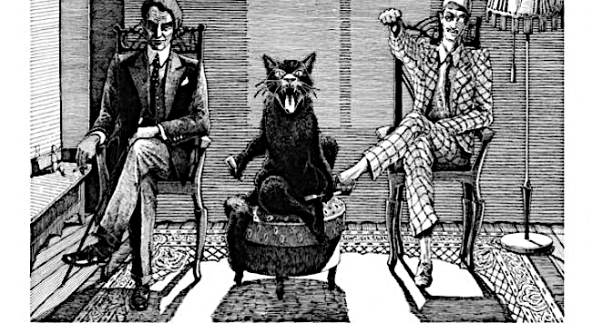
The Magic Shop and the Vice character
Wells as a scientist: is this science-fiction?
Aspect of futurism – is science-fiction connected to magical elements?
The shop assistants appearance – collect the adjectives that describe him!
The Magic Shop and Christianity
Comparative analysis: The Magic Shop and Bulgakov’s Master and Margarita
Sympathy for the Devil (The Rolling Stone) – How does 20th century literature change the perception of the Devil?
Does evil exist as a character or archetype in this short story?

Slide 13
William Faulkner: A Rose for Emily (1930)
Faulkner: part of the literary movement called the Southern Renaissance
His works often pinpoint the duality between North and South in the US
A Rose for Emily is set after the American Civil War: change in ideologies
Old South – male white ‘aristocracy’, wealthy property owners, slave labor
New South: modern world trying to achieve equality
Griers - Representing the Old South – Emily is called ‘a monument’
Southern Gothic style: decaying landscape, violence, racism, alienation, dark sinister theme. Characters are grotesque

Slide 14
A Rose for Emily
Look at the Facets of Focalization!
How does our horizon of expectation change about the story while the plot unfolds?
Narrator
Is the narrator reliable? Is he or she objective?
Why do we see the story from his/her perspective?
Isolation, refusal to change, move on
How many ‘Emilies’ do we get to know?
What does Emily represent on a symbolic level?
What does the House represent?
Similar narrative : Mouning Becomes Electra (drama trilogy)– Eugene O’Neill

Slide 15
Selkie Stories are for Losers (2013)
Sofia Samatar is an award winning American contemporary writer
Typical use of magical realism: the narrative takes place in a world that is almost identical to our world, but there are elements that refer to magic.
Selkie myth: half seal half human creature (Ireland, and surrounding islands)
They can become wives of men, but inevitably go back to being seals
The Selkie Bride, Goodman O Wasteness are two versions of the selkie story
Narration: 1st person - from a perspective of the daughter of a Selkie (possibly)
Realistic approach to a fairy tale – the leaving of the mother is painful and ruins her life

Slide 16
The Postmodern Condition
Plurality of languages – plurality of realities (Lyotard)
Retelling stories from a different perspective is popular in postmodernism
The grand narrative – Jean-Francois Lyotard’s term that describes a certain kind of coherent narrative that characterizes a certain age
In postmodernism the grand narrative is split into small narratives many ideologies and many truths – the truth of the Selkie daughter is as valid as the truth of the Selkie
The refusal of the One Truth – after the 1960 many theories started to focus on this plurality, questioning meaning, truth, existence
The ambiguity of meaning – the Grand Narrative is being questioned.

