Slide 1
Introduction to literary studies
Fall semester 15 September 2018
Zsofia.Marki@btk.ppke.hu

Slide 2
Introduction
What is an academic approach to literature?
Differentiation between facts, opinions and beliefs
Literary research: primary sources (literary text), secondary sources (books, articles), tertiary sources
Primary sources are materials you are directly writing about, the ‘raw materials’ of your research.
Secondary sources are books and articles in which other researchers report the results of their own research based on primary data. You quote or cite them in order to support your own research. This is where scholarship happens. Since secondary materials present original scholarship, they are also debatable.
Tertiary sources are books and articles based on secondary sources, on the research of others, synthesizing and explaining research in a field for a wider audience. They are helpful in the
From: Kiss Attila, Matuska Ágnes. “Introduction to the Study of Cultures and Literatures in English.” iBooks. early stages of research, because ”Excerpt

Slide 3
Literary criticism
1 Critic: a person who is professionally engaged in the analysis and interpretation of works of art
2 Critique: review, an essay or article that gives a critical evaluation (as of a book or play)
The complex nature of looking for meaning in a text
Horizon of expectations – based on your previous knowledge you expect something of the text
Context – horizontal: actual environment present when the text gets published
Context – vertical: history behind the text, references to traditions, historical facts, previous literary works

Slide 4
Literary genres: poetry
Three main literary genres: poetry, drama and prose (narrative fiction)
Sub-genres: novel, short story, tragedy, comedy etc.
Literary text do not represent reality.
Poetry is ‘expressive representation of a personal state of mind.’ Uses a so called figurative language
When we read in a poem “My love is a rose, and I love her truly”, we will realize that the poetic voice is actually not talking about a flower. Instead, the flower as a rhetorical device stands for the woman that is the object of love in the poem. In this case, the rhetorical figure is called a metaphor.
Excerpt From: Kiss Attila, Matuska Ágnes. “Introduction to the Study of Cultures and Literatures in English.”

Slide 5
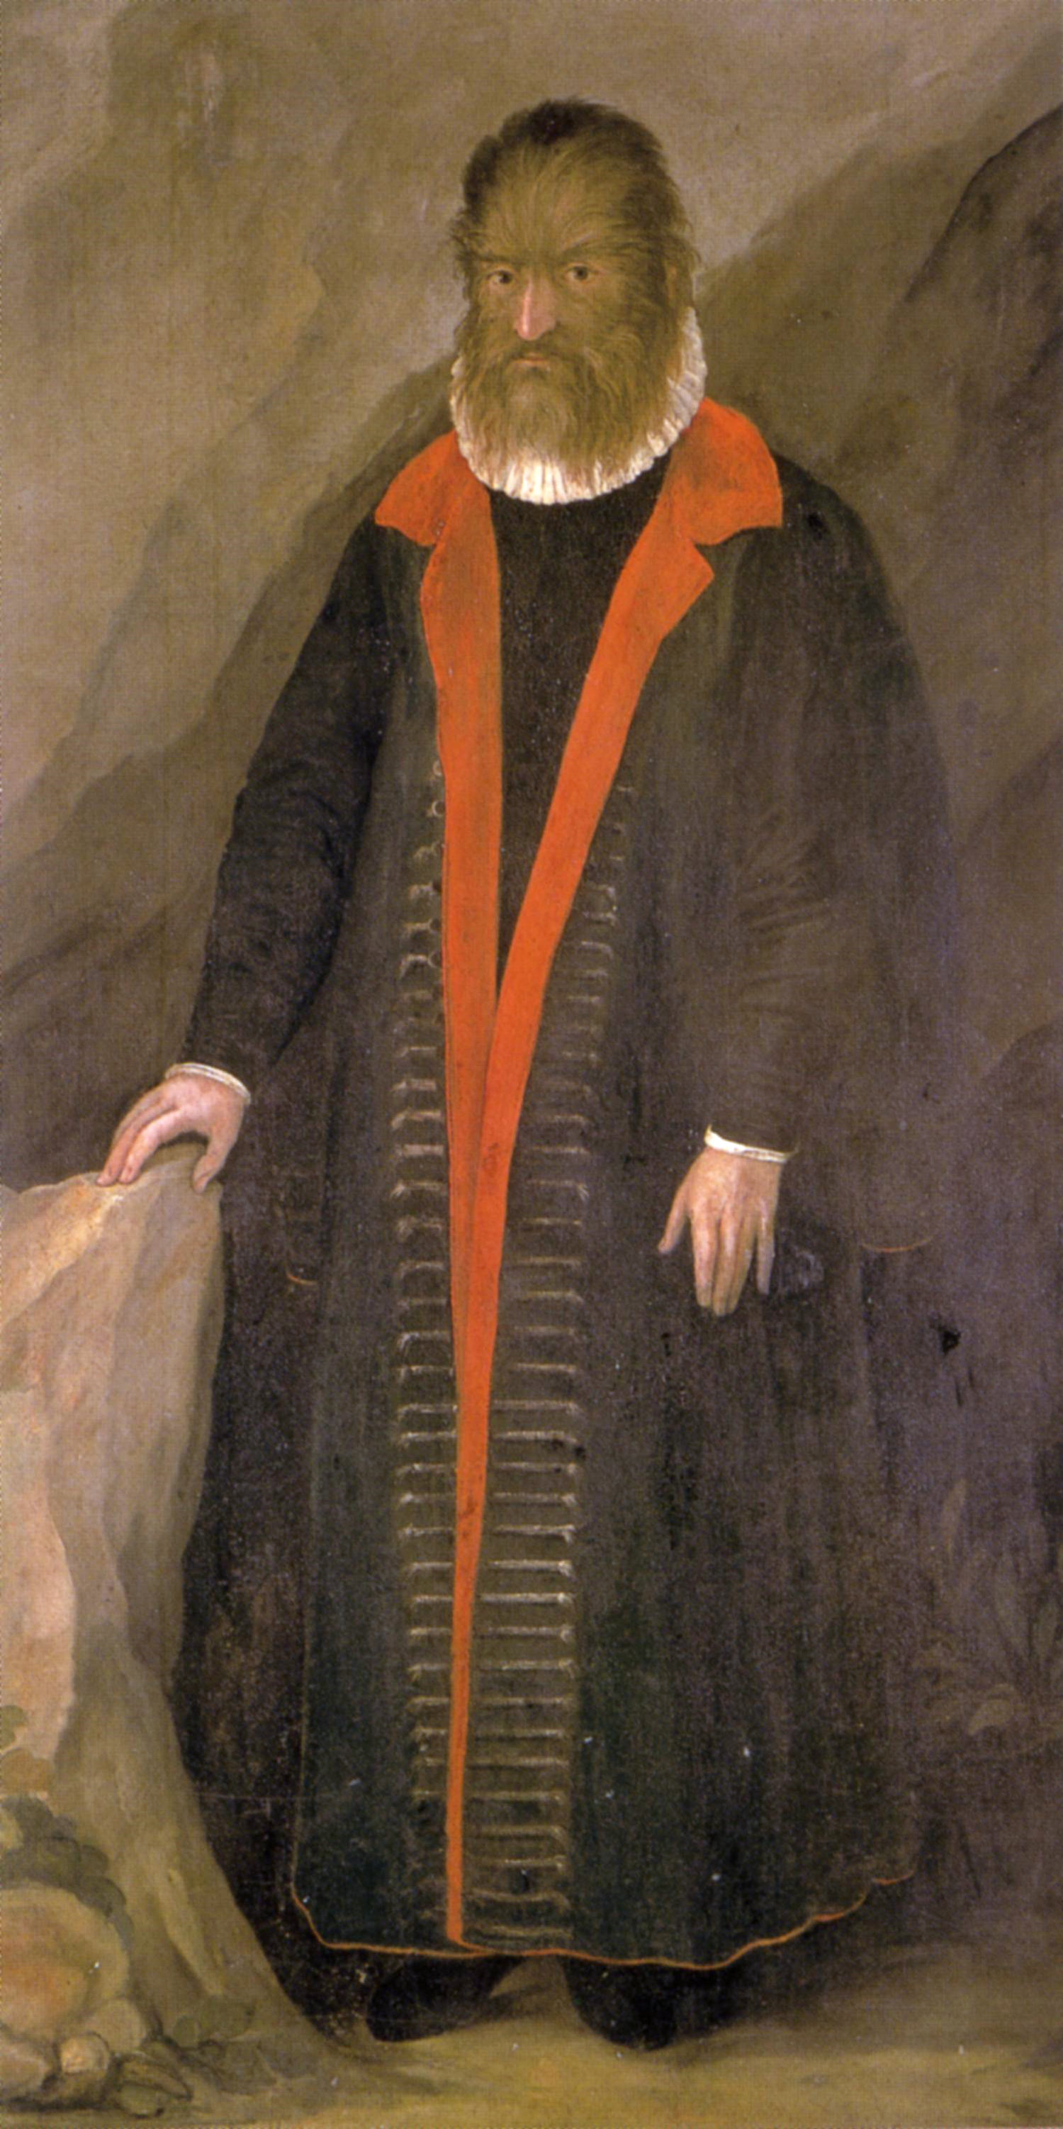
TED HUGHES: WODWO
Levels of understanding: first level – close reading of the text.
First reading: what do we know form reading the text?
Who is speaking?
What we don’t know?
Title: what is a wodwo? Wild man - mythology
What is the relationship between the title and the text?
Questions the narrator asks: ’What am I?’ Does he get an answer?
Describing very human activities: giving name to things, dissecting a frog
Question of freedom: ‘I’ve no threads fastening / me to anything I can go anywhere

Slide 6
Who is Ted Hughes?
Second level of understanding – contextual analysis
Who is the author, and is the author important in analysis?
‘The author is dead.’ (Roland Barthes)
Ted Hughes http://thetedhughessociety.org/life/
‘Born on 17 August 1930, Edward James 'Ted' Hughes would, over the course of his life, produce some of the most important and innovative poetry written in English in the twentieth century.’
Wodwo – collection of poems (London: Faber and Faber, 1967)
Collection to be read as an adventure, narrative (according to Hughes)
Theme of the collection: ‘must shamanize or die’ – rituals, myths, reconstruction of the self

Slide 7
Psychoanalytic approach
Third level of reading: theoretical approach – understanding the text with the help of tertiary literature – philosophy, psychology, literary theory.
One possible: psychoanalytical – Jungian approach.
The shadow – C. G. Jung: a part of the human psyche that resides in the unconscious
Archetype -
Wodwo – shadow being, an archetype representing the male shadow
Are humans more than animals?
What defines human existence? Do we have free will or slaves to the unconscious drives?

Slide 8
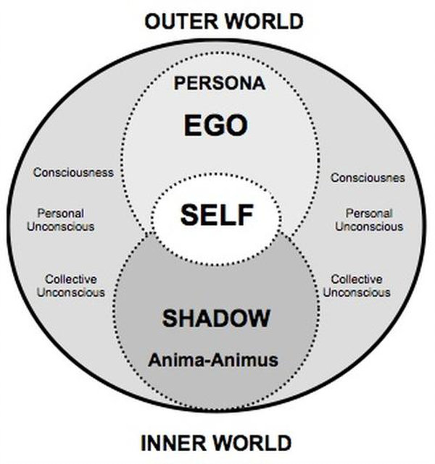

Slide 9
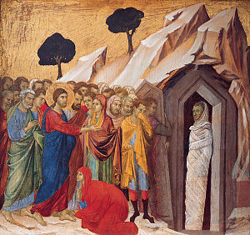
Sylvia Plath: Lady Lazarus
Main themes in the text:
Rebirth, death – where can you find them?
What is the relationship between the title and the text?
Historical references -
Personal life
Body parts, profanity – ‘there is a charge’, ‘strip tease’
”Out of the ash I rise with my red hair And I eat men like air.”
Is there a relationship between Wodwo and Lady Lazarus?

Slide 10
Comparative analysis
Comparative analysis uses two texts and analyzes the relationship between them based on one or few common themes.
Ted Hughes and Sylvia Plath were married between 1956 and 1962.
She was American he was English
Their relationship was violent, passionate
Ted Hughes was known for being hotheaded
Sylvia Plath battled clinical depression her whole life, committed suicide 1963
Common themes in both poems:
Reference to mythology
Reference to life and death

Slide 11
Mythology in Wodwo and Lady Lazarus
Mythical creature and mythical person representing a part of the psyche
Metaphor for the subject talking in the poem: Hughes IS Wodwo, Plath IS Lady Lazarus
Lazarus – resurrected by Jesus – mythical parallel is the Phoenix (‘out of the ash / I rise with my red hair’)
Feminizing a male character – feminist act.
Wodwo – human behavior, but events take place in nature
Archetypal elements – both mythical creatures represent archetypes reoccurring in literature
Further reading: Joseph Campbell: Hero with a Thousand Faces; Northrop Frye: Anatomy of Criticism

Slide 12
Sylvia Plath and Feminism
‘The anguish of female existence’ (Majumdar, Keya. Sylvia Plath as a Complete Poet. New Delhi, 2002. )
Relationship with Hughes – hotly debated, criticized as an example of patriarchal oppression.
The problematic idea of female roles: wife and mother
Empowering women: ‘I eat men like air’
Often depicted as a ‘martyr’ – neglecting the fact that she was clinically depressed and attempted suicide twice.
Father’s early death – depicted in the poem ‘Daddy’
Electra-complex – invented by late Freudians as the binary opposite of Oedipus-complex

Slide 13
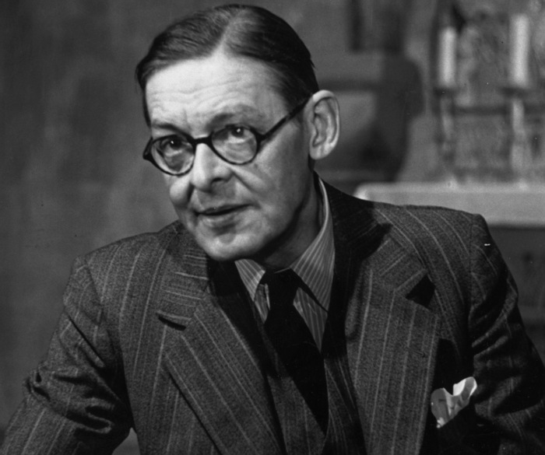
T. S Eliot: The Love Song of J. Alfred Prufrock
“Shall I part my hair behind? Do I dare to eat a peach? I shall wear white flannel trousers, and walk upon the beach. I have heard the mermaids singing, each to each.”
Close reading
Dramatic monologue – typical poetic style of T.S Eliot and English Modernism. A monologue in the voices of assumed personae.
Are there any rhymes or recognizable rhythm/meter?
Free verse. Repetitions.
Who is Prufrock? Is he T.S Eliot? – subject talking (narrator, speaker) versus author.
If there was a Prufrock-complex how would you define it?
Is this a love song?
Is there movement?

Slide 14
T. S Eliot: The Love Song of J. Alfred Prufrock
‘Prufrock is one of the great inventions of the modern literary imagination: he has become an archetype for the ‘complex’ of over-scrupulous timidity.’ (Seamus Perry)
Going nowhere – ‘Let us go then, you and I’ – other references to starting the movement – mapping the movements in the poem
“Time for you and time for me, And time yet for a hundred indecisions, And for a hundred visions and revisions, Before the taking of a toast and tea.”
Growing anxiety further we go into the poem
Growing old

Slide 15
T. S Eliot, the Modernist
Looking at Eliot’s poem from Eliot’s perspective
Eliot was a poet, a writer and a literary critic
Tradition and the Individual Talent – Published in a collection of essays The Sacred Wood (1920)
Eliot emphasizes the importance of tradition
‘on the shoulders of giants’ – greatest art is achieved by learning from the giants of the past
Eliot’s biggest influence was the poet Robert Browning – who was a prolific user of the dramatic monologue.
Allusions: a figure of speech that refers to a well-known story, event, person, or object in order to make a comparison in the readers' minds.

