Slide 1
Introduction to literary studies pt2
Drama
Fall semester, 28 September 2018. marki.zsofia@btk.ppke.hu

Slide 2
Introduction to Reading Drama
Origins: rituals, games of make-belief, imitative action. Later fertility plays, where Spring was battling Winter, then conflicts of people and the supernatural. Dramas were written for the live performances.
Greek drama – social and cultural event. Renaissance drama – popular culture. From 17th century drama slowly becomes high culture, huge theatre buildings appear.
The main modes of drama: tragedy, comedy, romance, satire, tragicomedy
Specific identifiable form: dialogue, stage directions, names, author-narrator not visible
Odd example: http://members.efn.org/~dredmond/Hamletmachine.PDF
Performance studies: one text – many performances (in modern times)
Before printing: many versions existed of one play
Drama text vs performance text – drama studies vs performance studies

Slide 3
Introduction to Reading Drama
What kind of stage was the play written for?
When we read a drama, for the understanding of the possible worlds represented in the text it is often indispensable to know the kind of theatre and the kind of representational logic of the stage for which the text was intended.
Horizon of expectations: if you don’ know the circumstances, you might have a different interpretation, or even not see hidden meanings in a play.
In each era drama was presented in different ways: different shapes of theatres, attitudes, women played by men, masks, high culture or popular culture theatres, religious or secular topics etc.
Stages were always changing according to to historical-cultural context

Slide 4
Drama text
Information gap: we don’t know anything aside the dialog, have to fill in the gaps
“Special attribute of the dramatic text is that it uses words to create action through the dialogue of characters in a situation which is just happening. The dramatic text always concentrates on the here and now of an action, it intensifies the referentiality of the text, and for this purpose it uses a special capacity of language called deixis. Deictic language draws the attention to the here and now of the speech act (here, there, now, look, see, etc.)” (Kiss A, Matuska Á., 227)
The text as an always changing entity: each published print of the same LWA can be different even today. Text is not as stable as we think.
Shakespeare’s Hamlet has three known versions: Q1, Q2, F1.
Q1 – called the bad Quarto, probably a transcript by an actor, who worked based on memory

Slide 5
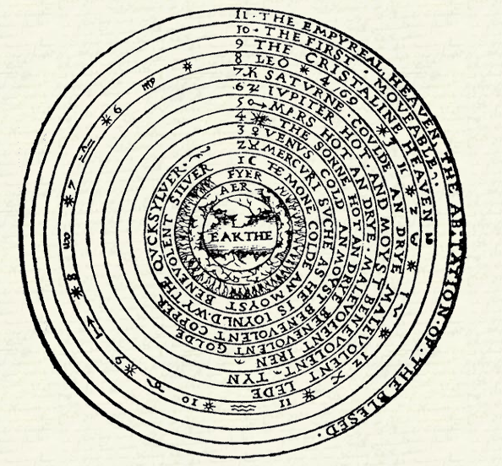
Birth of the Renaissance Drama
Other names: Early-Modern English Drama, Elizabethan Drama
Developed from Medieval dramas – morality plays, nativity plays, liturgical dramas
Allegorical events and characters: Everyman (cc 1490): e.g Mankind (1475),
Psychomachia – fight of opposing spiritual forces (evil and good)
1500s – interludes: small allegories played out in ballrooms of the aristocracy
Secularization of drama: non-religious themes.

Slide 6
Humanist Movement and Theatre
The influence of classical (ie. Greek and Roman) drama and philosophy.
School reform: classical dramas become part of the curriculum
Comedy: influence of Plautus and Terrence
Tragedy: influence of Seneca (Tenne Tragedies 1581) – drama is rhetorical in character : the birth of monologues.
Horror, passion become part, but only told and not shown (as in classical dramas)
Inns of Court: Cambridge, Oxford. Schools where upper-class men trained to be lawyers. Students and teachers copied classical plays, and rewrote them.
First playwrights: Ben Johnson, Thomas Kyd, Christopher Marlow

Slide 7
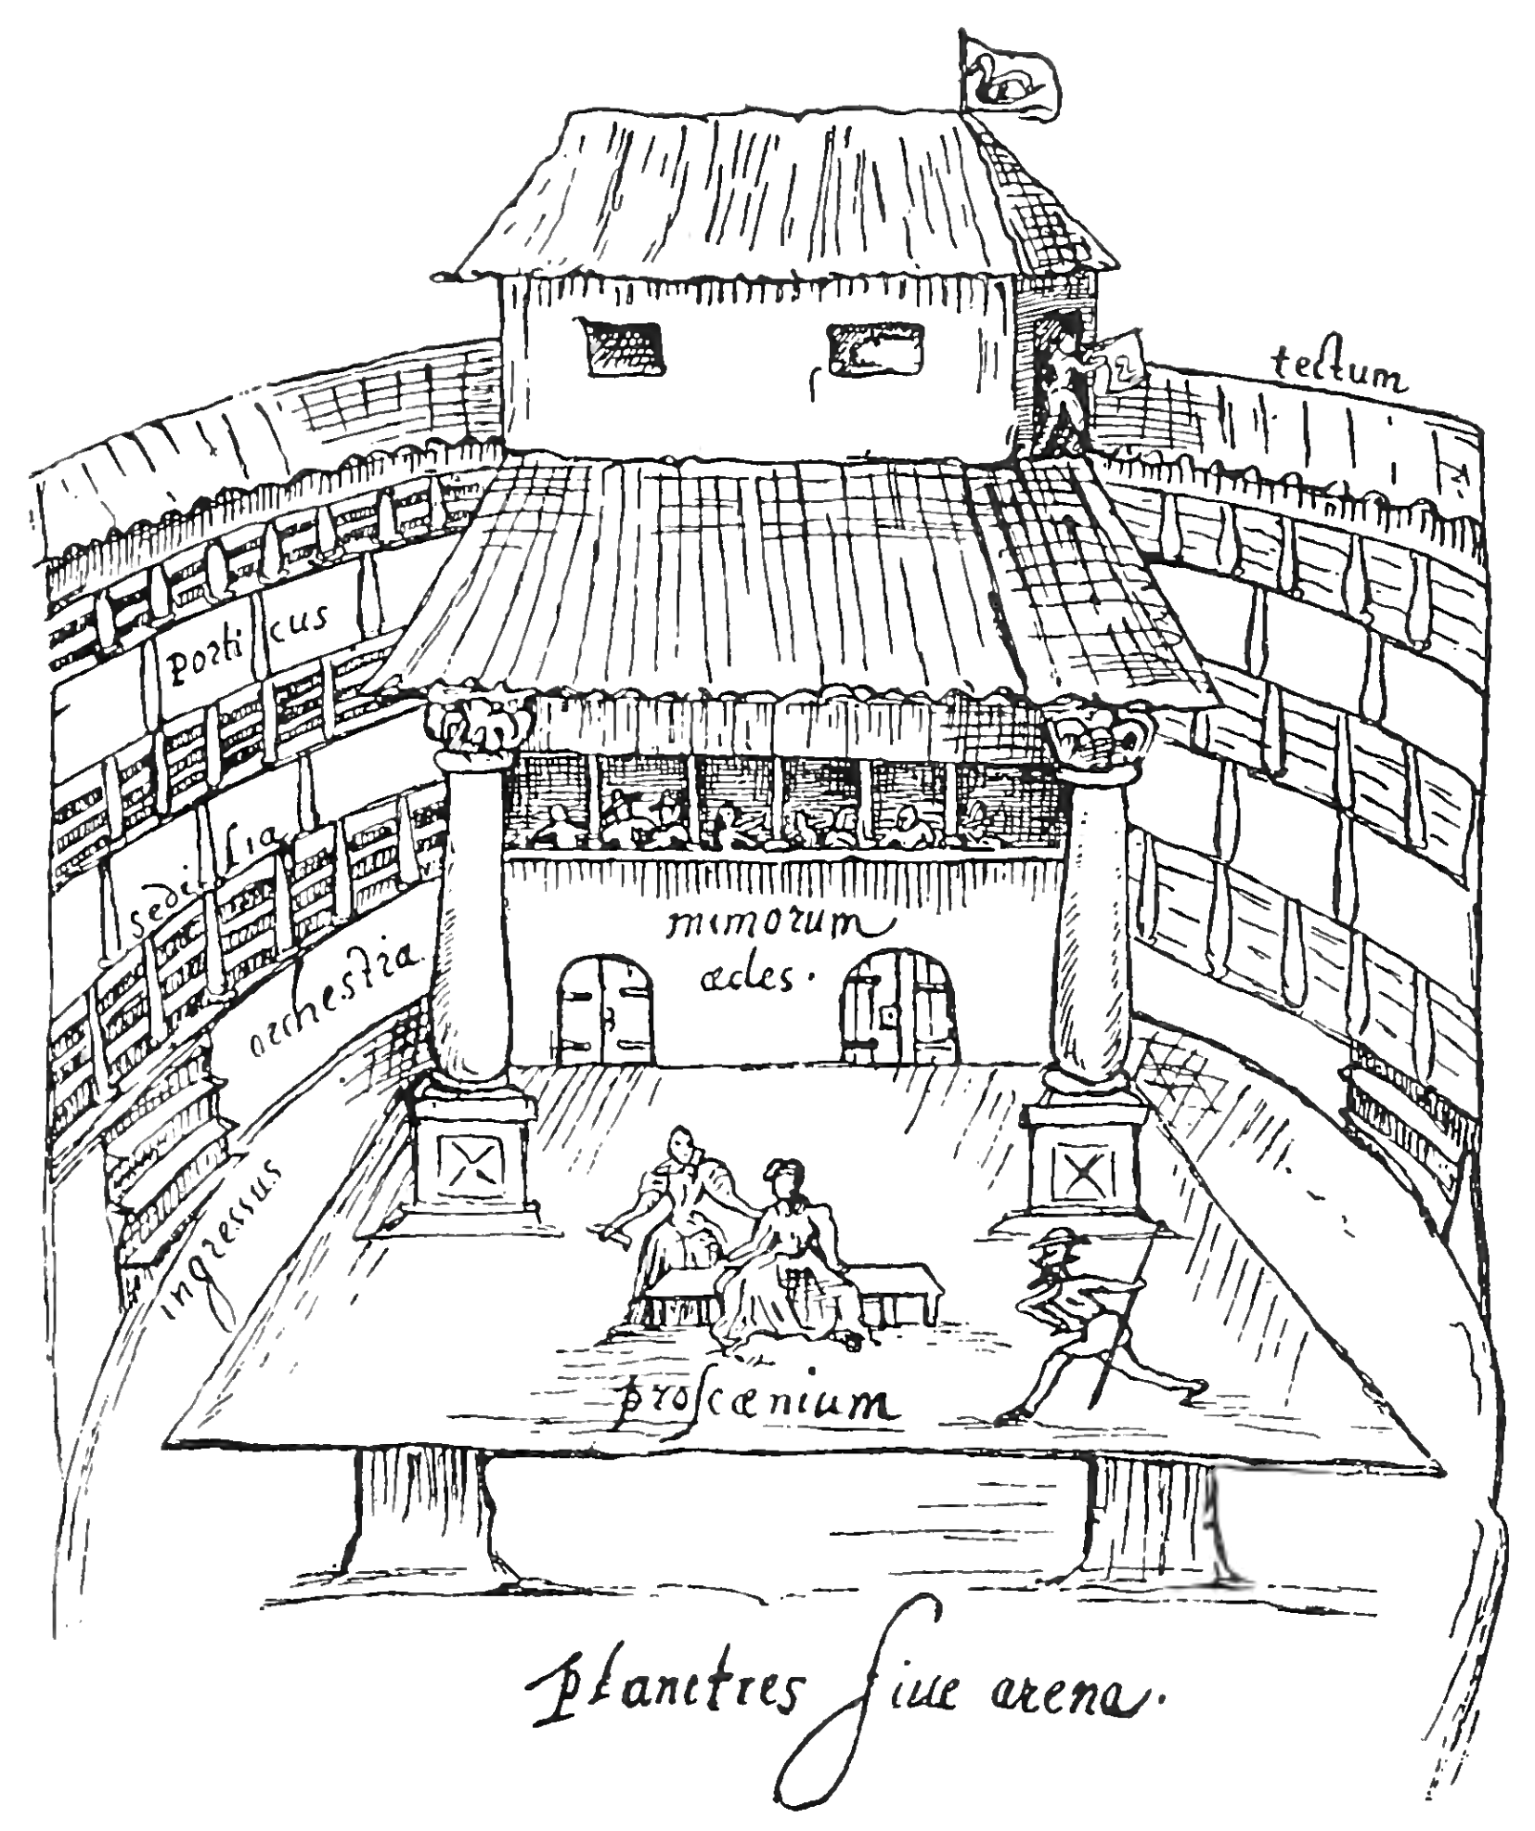
The Stage as Microcosm
Medieval iconography of the micro and macrocosm.
Stage is a representation of the world.
Balcony: heavens
Trap door – door to hell
Shape of theatres round.
Public theatres: Rose, Fortune, Swan, Globe
Almost 3000 spectators could fit in
Outskirts of the town, popular, secular, socially heterogenous, cheap
Further reading: Fabiny, Tibor (Ed.). Shakespeare and the Emblem. Studies in Renaissance Iconography and Iconology. Szeged, 1984.

Slide 8
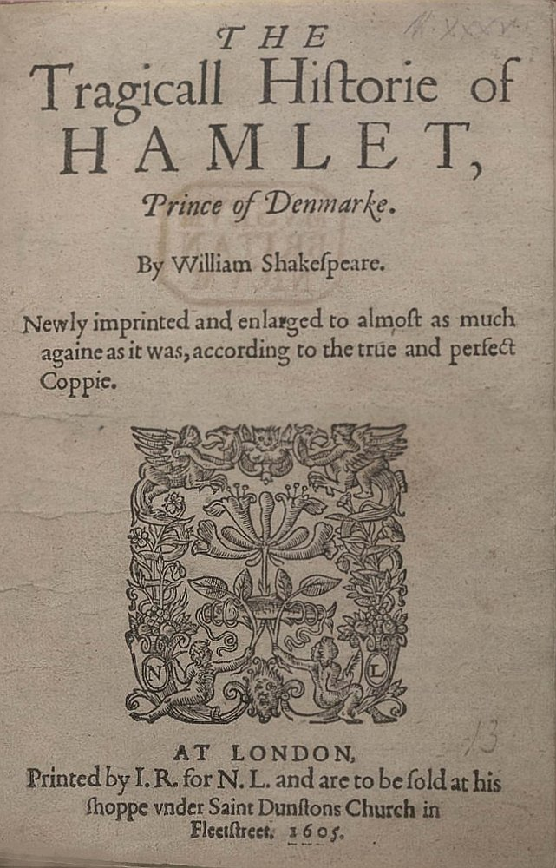
Hamlet on Elizabethan stage
Hamlet myth had been around for decades (myth of Amleth)
So called Ur-Hamlet, the first stage version commonly associated to Thomas Kyd
Reading Hamlet with Early-Modern stage in mind.
Looking at scenes differently: ghost scene, graveyard scene - Hamlets in hell.
Play within a play: microcosm within the microcosm – meta drama.
“Get thee to a nunnery” – nunnery as a brothel.

Slide 9
Hamlet in Purgatory
Though in drama there is only text, and no one speaker, not all characters are equally reliable.
Hamlet in Purgatory – Stephen Greenblatt
Hamlet’s indecisiveness – his knowledge of the murder comes from the Ghost
In Elizabethan times ghosts generally thought of as evil characters, not reliable
Old Hamlet is in purgatory – this is where ghosts come from
All young Hamlet is looking for, is real proof. Read the scene, compare adaptations.
Russian Hamlet Ghost scene:
https://youtu.be/5XWbGN0zmlw?t=1248
Reduced Shakespeare Company Ghost Scene: https://youtu.be/BvPdWcCHkxM?t=126

Slide 10
Hamlet and Women
Female characters in Shakespeare’s time: played by men on stage, usually few lines. Hamlet has very bad opinion about women:
‘Frailty – thy name is woman!’(Act I, Scene 2)
‘Get thee to a nunnery’ scene (Act III, Scene 1)
Bedroom scene with Gertrude (Act III, Scene 4)
Ophelia – feminist reading: mirror of Hamlet without patriarchal power.
Gertrude – Why does she drink poison in the las scene?

Slide 11
Myths and Hamlet
Hamlet as Electra: revenge of the murder of the father – the good king. Usurper: Claudius.
Hamlet’s Oedipus complex
Killing of the Divine King: (James G. Frazer, The Golden Bough) – if the king becomes corrupted, sick, ill or old, he must be killed. In this sense the king represents the country. If the king is sick the country is sick.
King Hamlet was murdered – the new king is a murderer
Hamlet goes mad – he is the heir to the throne, but by killing his uncle, he himself becomes corrupted.

Slide 12
Shakespeare, Hamlet, Canon
Is Hamlet, Prince of Denmark the greatest English play of all time?
Is William Shakespeare the greatest English playwright?
Canon (Greek: measuring rod, standard)
The process of canonization: originally referring to canonization of scripture in the Bible
Western literary canon
Folger Shakespeare Library https://www.folger.edu/ - sources for research (bibliographies, stage versions, primary texts, etc)
Perpetual re-telling of stories: Hamlet, and its many adaptations
How to perform something that has become a cliché?
https://youtu.be/N5C3VavvSUo?t=645

Slide 13
Adaptation, and it’s theories
First literary adaptations to film started with the creation of cinema
Adaptation of Shakespeare’s King John, 1899.
Shakespeare has 410 screen adaptations
Not only screen adaptations:
Heiner Müller: Hamletmachine, 1977
Tom Stoppard: Rosencrantz and Guildenstern are Dead, 1966.
Shakespeare’s plays had rewritten versions with different endings in the Restoration (18th century)
Theory of adaptation first only concentrated on literary adaptations to screen
Brian McFarlane: Novel to Film, 1996.

Slide 14
Adaptation, and it’s theories
Later theorists expanded it to every possibility: novel to film, film to novel, film to film, drama to novel, novel to video games and so on.
Linda Hutcheon: A Theory of Adaptation – is the most expansive an thorough description so far.
Defines adaptations as:
Formal entity or product: transposition of a work that can involve a shift of medium
Process of creation: it involves re-interpretation and re-creation, appropriation, salvaging
Process of reception: it is a form of intertextuality – it is engaged with the adapted work

Slide 15
Rosencrantz and Guildenstern are Dead
No! I am not Prince Hamlet, nor was meant to be;
Am an attendant lord, one that will do To swell a progress, start a scene or two, Advise the prince; no doubt, an easy tool, Deferential, glad to be of use,
Politic, cautious, and meticulous;
(T. S. Eliot's The Love Song of J. Alfred Prufrock, 1917)
Two insignificant characters from Hamlet become main characters
The last words of the play become the title
Two characters ultimately looking for their role. Is it a tragedy or a comedy?
Can you understand the play without knowing Hamlet?
Does the play give any commentaries on Shakespeare’s play?
Does knowing Hamlet change your perception of the play?

Slide 16
Rosencrantz and Guildenstern are Dead
Existential questions:
” All your life you live so close to truth, it becomes a permanent blur in the corner of your eye, and when something nudges it into outline it is like being ambushed by a grotesque. “
What questions do they bring up during the play?
How do they think of death?
Do they have free choice or was everything determined?
They don’t seem to remember anything before they were on the road. Are they even real people?
The play is looking at what the characters do behind the scene, when they are not on stage (not the actors)

Slide 17
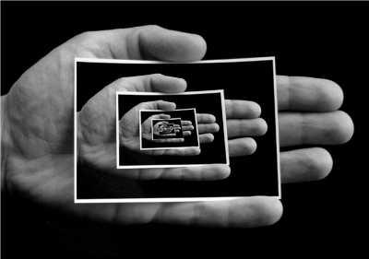
Plays within plays within plays…
Mise-en-abyme
The perpetual repetition of watching and being watched
Perpetual repetition of death
Perpetual repetition of coin tossing
Repetition of questions
Audience watches R and G watching the play within a play scene
Does this mean that everything repeats itself?

Slide 18
Stoppard and his time
Stoppard is perhaps best characterised as a post-modernist writer, someone who self-consciously interrogates and reflects upon the fragments of the culture he has inherited. (Robert Gordon, 1991)
Post-war dramas:
Tradition of characters that are not heroes
Typically in Beckett’s plays (Waiting for Godot, especially Endgame)
Characters waiting for their doom to come
Did they ever had a choice?
” GUIL: Our names shouted in a certain dawn ... a message ... a summons... there must have been a
moment, at the beginning, where we could have said-no. But somehow we missed it. “

Slide 19
Gertrude Talks Back
Margaret Atwood, Canadian contemporary author
Most of her work deals with complex, ambiguous women, questioning of classical female roles, oppression (The Handmaid’s Tale, Alias Grace, The Blind Assassin)
Gertrude Talks Back – rewriting canonical portrayal of women
Published in a short story collection Good Bones (O. W. Toad, 1992)
Based on Shakespeare’s play: what do we know of Gertrude?
Does Atwood’s approach change the bedroom scene between Hamlet and Gertrude?
Can we still talk about Oedipus-complex?

Slide 20
Gertrude Talks Back
“The character of Hamlets mother has posed problems of interpretation to readers, critics and performers, past and present, and has been variously or simultaneously appraised as a symbol of female wantonness, the object of Hamlets Oedipus complex, and an example of female submissiveness to the male principle (Hamlets as much as Claudius). Like other revisionist rewritings produced by women writers in the last few decades, Margaret Atwood’s short story challenges received concepts of the female, and particularly the ‘Frailty, thy name is woman’ notion that has marked so much canonical literature.”
Based on Shakespeare’s Hamlet, do we know if Gertrude took part in the murder of the King?
By admitting the murder, what changes?

Slide 21
Two adaptations
What is the similarity between the two adaptations?
How do they approach the original text and the original plot?
Do they change the plot of the Shakespearean play?
Do they add anything to the intertext of the play?
Intertextuality: a concept that assumes an interrelationship between texts. These can be similar texts, quotes, allusions, adaptations, parody, translations etc.
Hutcheon: the intertextual cloud of a certain work contains the adaptations and the original text as well. They should be treated equally.

