Slide 1
The Cold War
Historians’ Approaches
Timeline
Fighting the Cold War Inside

Slide 2
Theory
Where historians differ…
Traditionalists
Revisionists
Rejecting the dualistic approach
Kennan’s “Long Telegram”: the idea of containment
Republican criticism of Kennan’s containment -> radicalizing US foreign policy

Slide 3
Beginnings of the Bipolar System
US Cold War institutions
National Security Act of 1947
integrated Department of Defense
CIA
National Security Council
Hardening relationship with the Soviet Union
Greece and Turkey -> the Truman Doctrine (12 March 1947) officially endorsed the containment policy
The Marshall Plan of 1947
The Berlin-crisis (1948-49) and the Berlin airlift
April 1949: the establishment of the NATO

Slide 4
Conservative Pressure
1949
John Foster Dulles
Rollback of Communism
Confrontational attitude vs. rhetoric
1953: workers’ uprising in Berlin
1956: Poznań and Hungary
the first détente
the Cold War transferred to the third world
1957: the Soviets launched the first sputnik -> American territories vulnerable
Eisenhower Doctrine: the US would not tolerate the advancement of Communism in that region

Slide 5
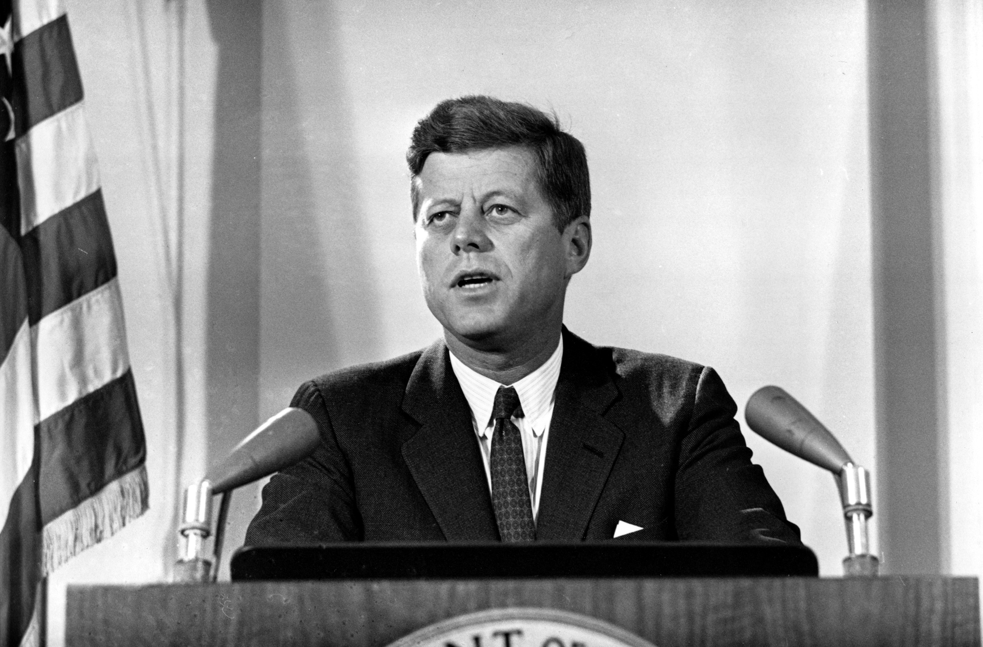
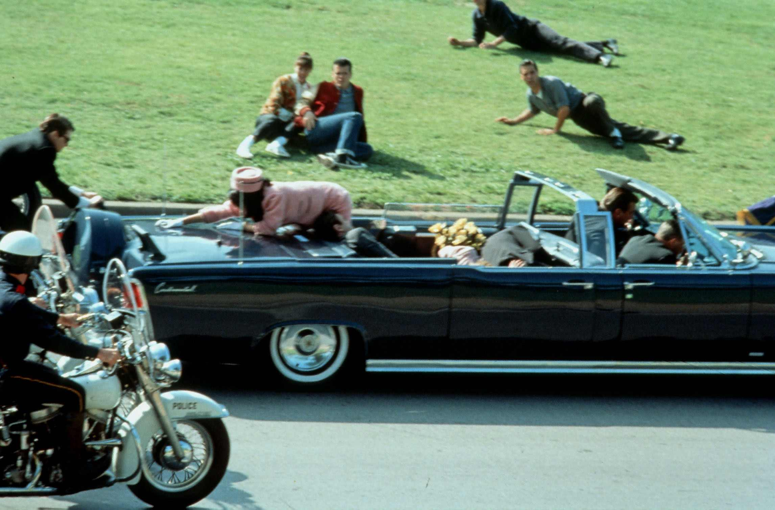
The Kennedy Era

Slide 6
End of the détente
Berlin Wall in 1961
Cuban Communist victory (Fidel Castro)
1961: the failure of US landing in the Bay of Pigs
1962: Cuban Missile crisis
Nuclear Test Ban Treaty (August 1963)
US bilateral relations with Communist European countries

Slide 7
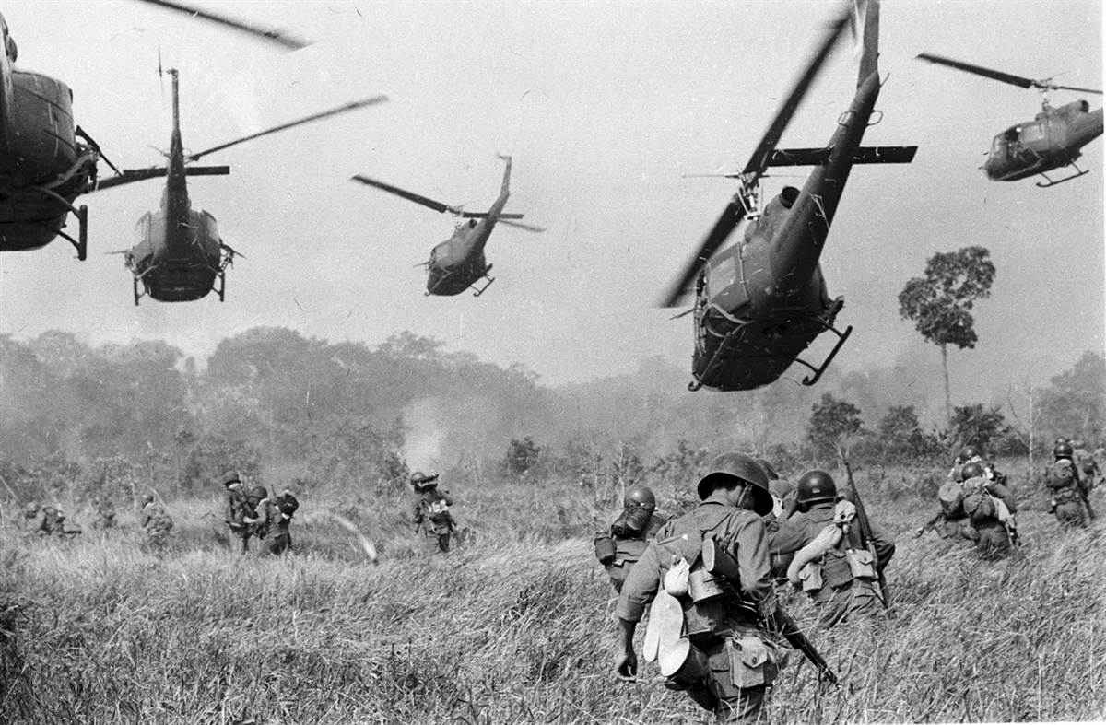
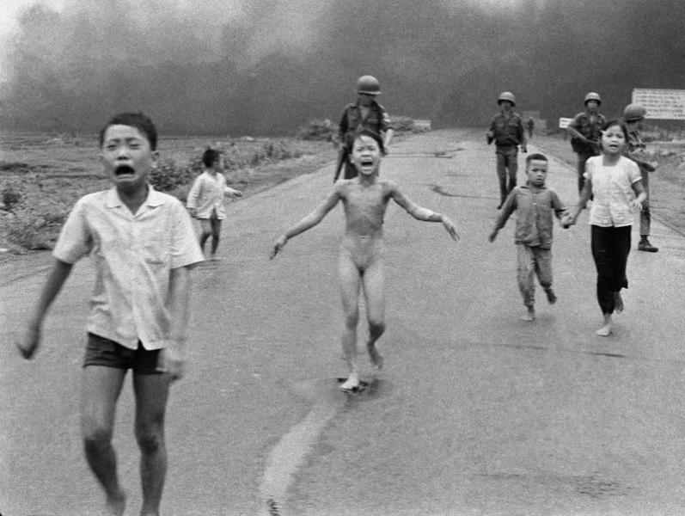
The Vietnam War

Slide 8
Early 1950s: financial support to the French
1954 Geneva Accords – North and South (17th par.)
Diem’s regime in the South
1964: the Tonkin Gulf incident
American Withdrawal
1968: Nixon’s promise to “Vietnamize” the war
1969: the Nixon Doctrine: the US would not fight local wars instead of the local forces
1973: end of the Vietnam War

Slide 9
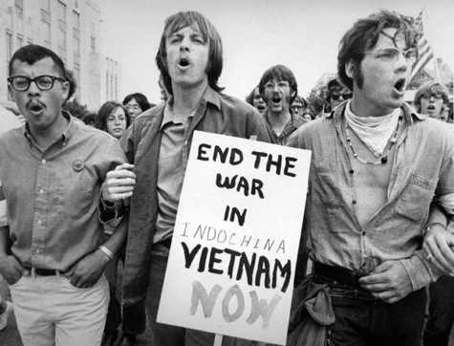

Slide 10
Fighting The Cold War at home

Slide 11
Roots of Anti-Communism
Roots of the second “red scare”
1920s: paranoia, conservative fears of Communist plots
The Saco-Vanzetti case (1927)
Anti-Communist propaganda during WWII
1938: House Committee on Un-American Activity (HUAC)
1940: Smith Act: restricted radicals’ freedom of speech and of assembly

Slide 12
The Beginnings of the Cold War at Home

Slide 13
“Internal containment” in the immediate post-WWII years
constraints on Truman’s administration to prevent Republican charges
Hollywood purges (1947)
After 1949
Until 1951: 2500 persons dismissed from federal offices
1950: McCarran-Walter Security Act: immigration law passed over Truman’s veto

Slide 14
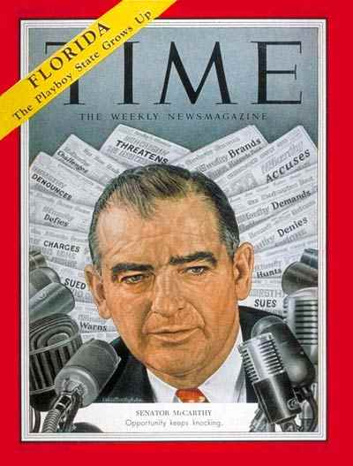
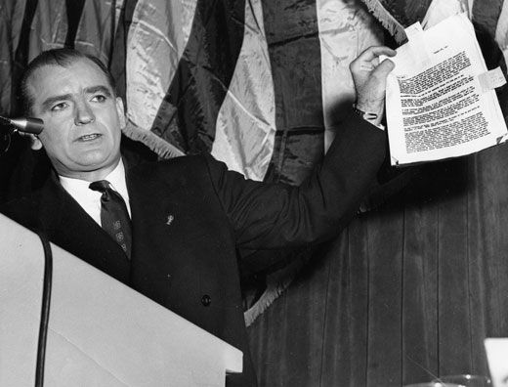
McCarthyism

Slide 15
Senator from Wisconsin
Wheeling speech
the overall character of the speech: anti-intellectual, emotional, manipulative, engendering paranoia and fears, affecting the sentiments of the “hidden” middle class, conservative, religious people
the Rosenberg case (1953)
End of McCarthyism
embarrassing for the Eisenhower administration
Cooling off after Stalin’s death in foreign policy
McCarthy personally discredited himself at Senate hearings
Civil rights era

Slide 16
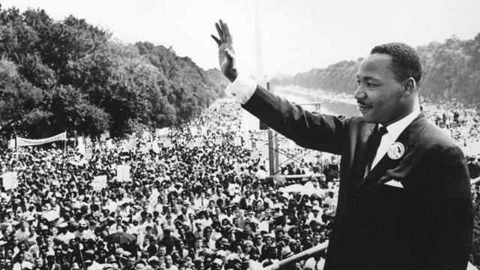
The Civil Rights Movement

Slide 17
Beginnings
Plessy vs. Ferguson – „separate but equal”
Jim Craw laws
NAACP (1909)
1954: Brown vs. Board of Education of Topeka, Kansas
Resistance to desegregation (Little Rock, 1957)

Slide 18
Martin Luther King
The Montgomery bus boycott – Rosa Parks
MLK becomes the leader of the boycott movement -> SCLC
“Sit-in” movements
“Freedom rides”: testing desegregation in interstate coaches
March on Washington, DC: MLK’s “I Have a Dream” -> break with the radical groups of the civil rights movement

Slide 19
Radicalism
1965: Black Power
1965-8: race riots in LA, Chicago, Cleveland, Detroit
Malcolm X: “The Ballot or the Bullet” (1964)
Murders of MLK and Malcolm X
Black Panther Party (1966): reject negotiation with whites
Loss of faith in the administration, consumer society, indifference, inertia, and “establishment” in general

Slide 20
Achievements
Brown vs. Board of Education of Topeka
Voting Rights Act (1965) – “Minority Districting”
Civil Rights Acts of 1964 and 1968
Modern Feminism
Indian Rights (of the Civil Rights Act of 1968)
affirmative action
PC

Slide 21
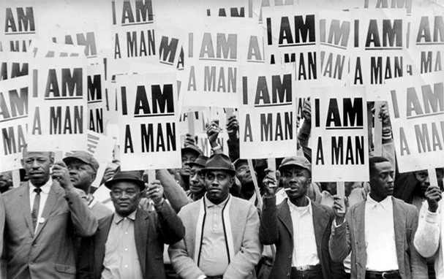

Slide 22
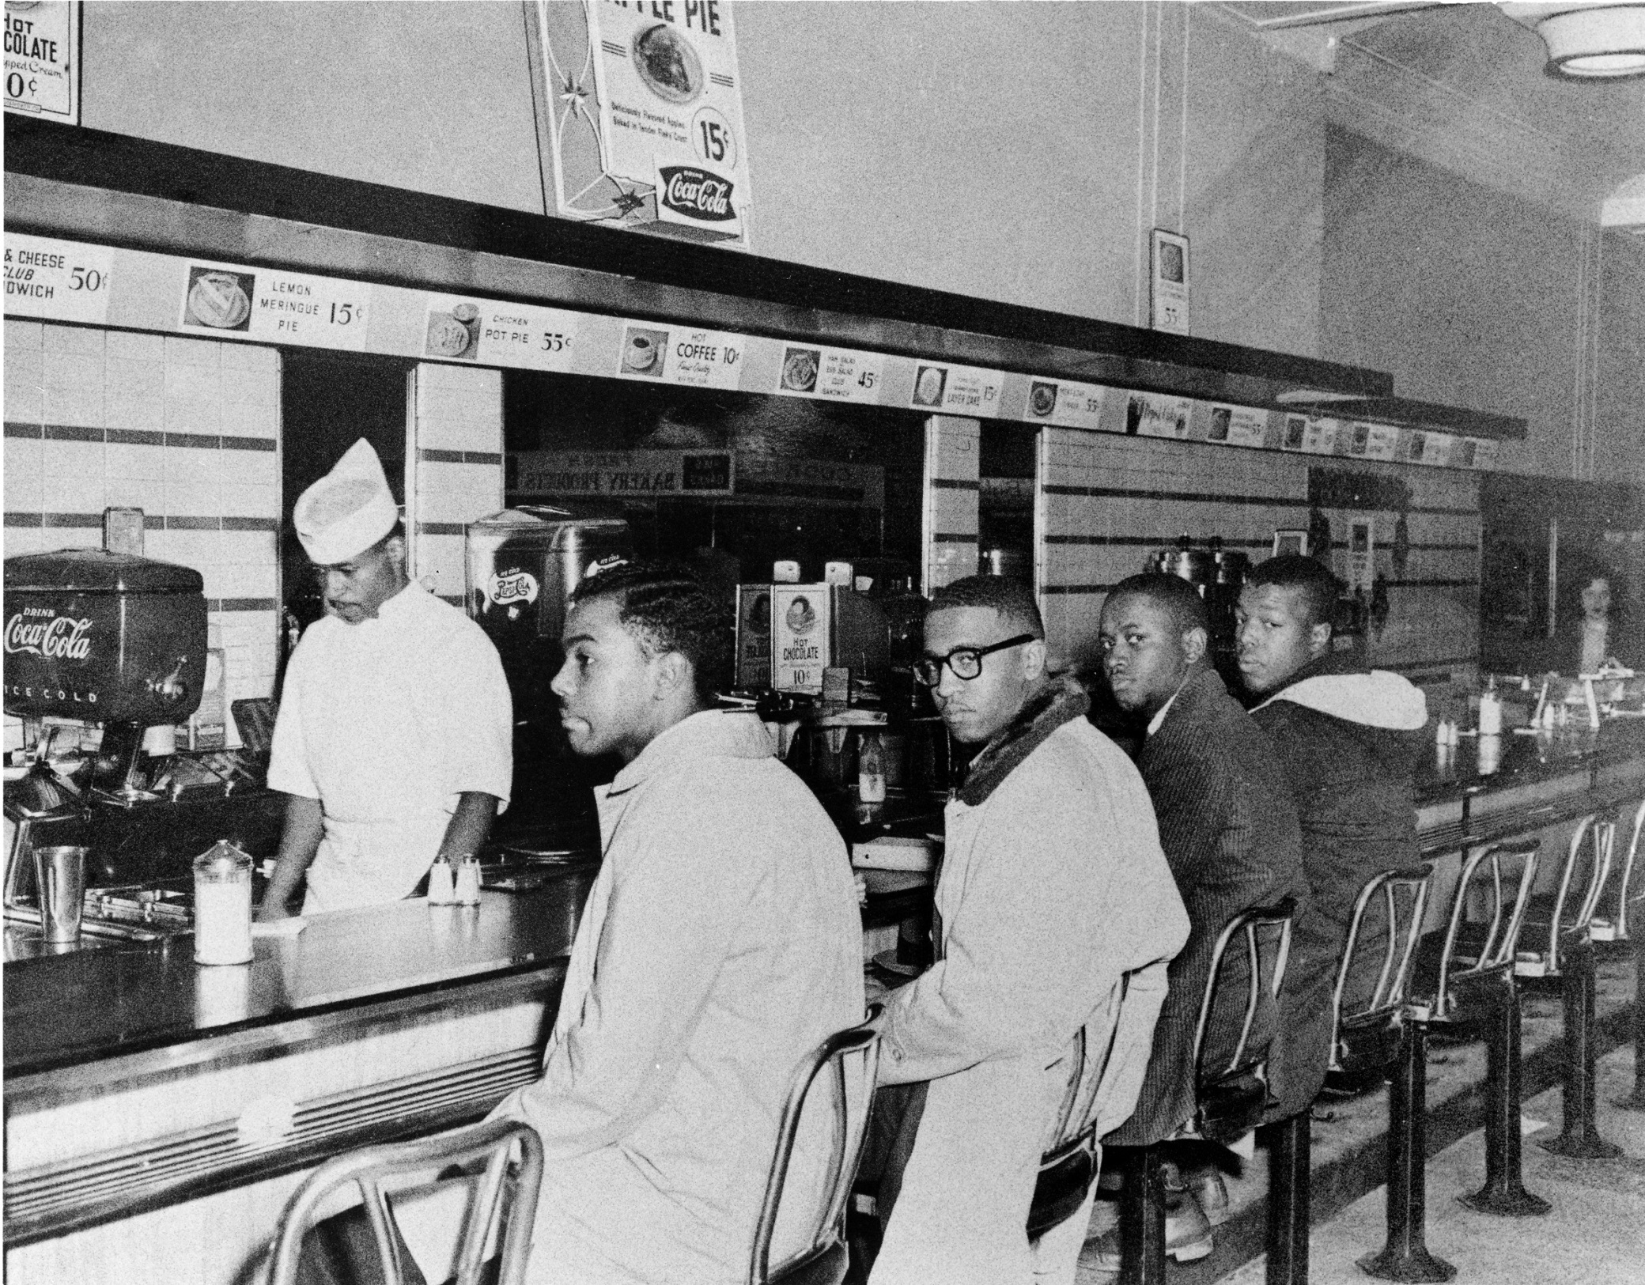

Slide 23
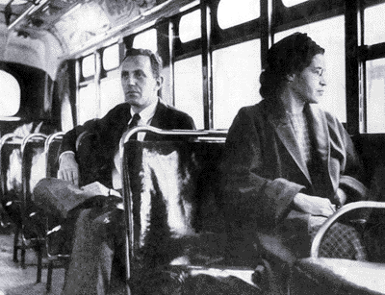

Slide 24
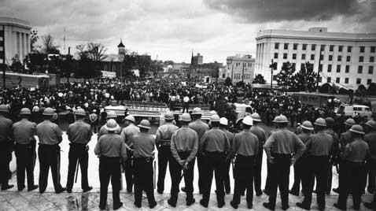

Slide 25
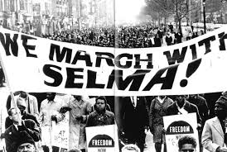
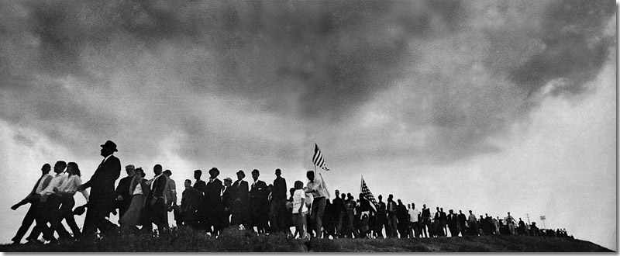

Slide 26
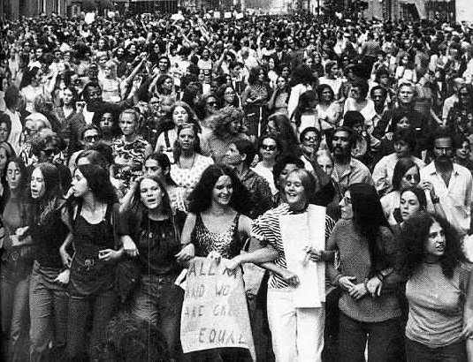

Slide 27
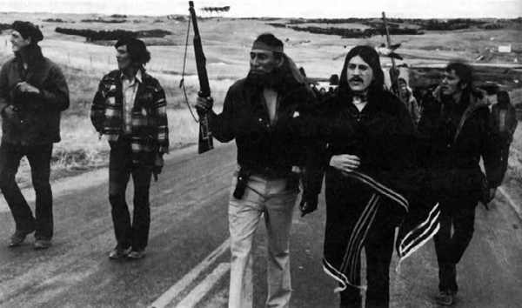

Slide 28
The Great Society
Kennedy’s “New Frontier”
L. B. Johnson’s “Great Society”: linking the idea of civil rights with the war on poverty
Educational improvement by the “Head Start” program
“Upward Bound” aiding disadvantaged children
Medicare and Medicaid

Slide 29
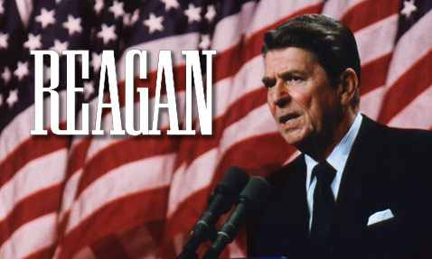
Neoconservatism
1970s-1980s

Slide 30
Republican era after 1968
Nixon, Reagan, Bush
The “New Right”
Growing strength of the conservative movement:
1972: Debate of the ERA
Nixon administration: busing only as the last resort to desegregate schools
1978: Bakke vs. University of California Board of regents
1979: Jerry Falwell’s Moral Majority -> accommodationism
Ronald Reagan’s “Second American Revolution”
Dismantling the welfare state
Cutting taxes
Laissez-faire economy (Milton Friedman)
Armament –the second cold war

Slide 31
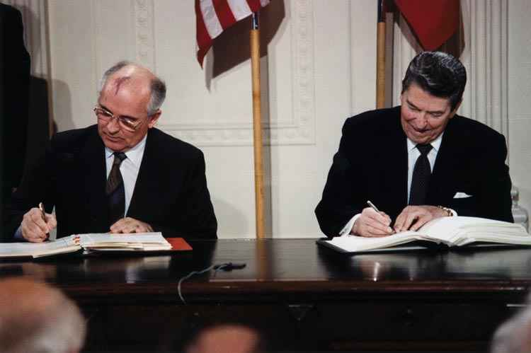

Slide 32
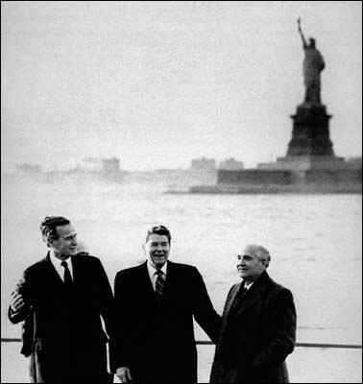
End of History?

Slide 33
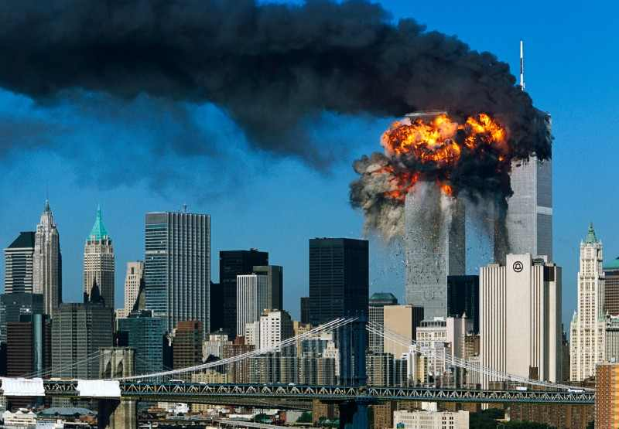

Slide 34
